Slide 1

Microprocessors and Assembly Language Fall 2019
Hamed Farbeh
farbeh@aut.ac.ir
Department of Computer Engineering
Amirkabir University of Technology
Lecture 4

Slide 2
Copyright Notice
Parts (text & figures) of this lecture are adopted from:
Arm Assembly Language Programming and Architecture, Volume 1, 1st edition, Muhammad Ali Mazidi, Sarmad Naimi, and Sepehr Naimi, MicroDigitalEd, 2013.
Microprocessors and Assembly Language, Fall 2019, AUT, Tehran, Iran

Slide 3
Why to Learn Assembly Language
HLL can greatly enhance programmer productivity, BUT
Writing assembly code is desirable or necessary for
The first steps in booting the computer
Code to handle interrupts
Low-level locking code for multi-threaded programs
Code for machines where no compiler exists
Code which needs to be optimized beyond the limits of the compiler
On computers with very limited memory
Code that requires low-level access to architectural and/or processor features
Write a compiler
Program device drivers
Microprocessors and Assembly Language, Fall 2019, AUT, Tehran, Iran

Slide 4
ARM Architecture and Assembly Language Programming
Microprocessors and Assembly Language, Fall 2019, AUT, Tehran, Iran

Slide 5
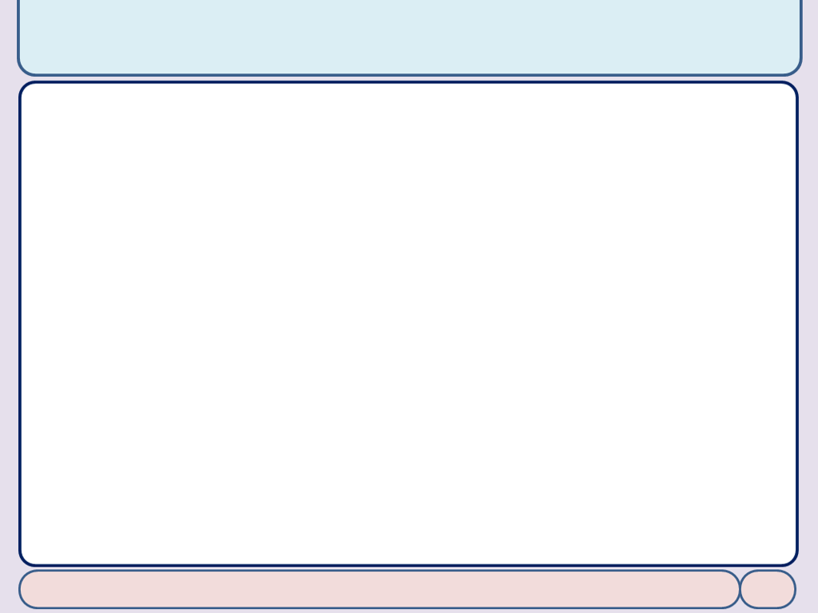
SUB Instruction
We have already seen MOV and ADD instr.
SUB Rd, Rn, Op2 ; Rd = Rn – Op2
A simple code
MOV R1, #0x34 ; load 0x34 into R1 (R1 = 0x34) SUB R5, R1, #0x25 ; R5 = R1 – 0x25 (R5 = 0x34 – 0x25)
Microprocessors and Assembly Language, Fall 2019, AUT, Tehran, Iran

Slide 6
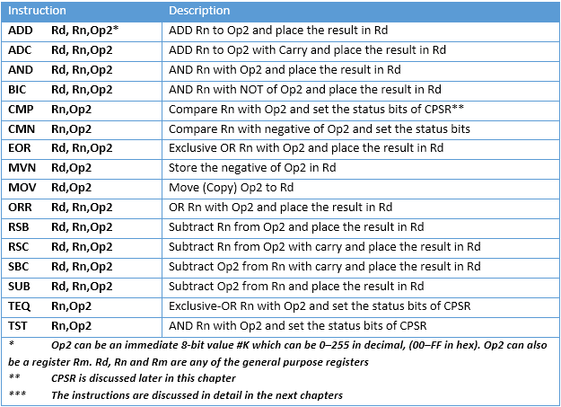
ALU Instructions Using GPRs
Microprocessors and Assembly Language, Fall 2019, AUT, Tehran, Iran

Slide 7
The ARM Memory Map
Memory space allocation in the ARM
4 gigabytes of directly accessible memory space
from 0 to 0xFFFFFFFF
Memory space can be divided into five sections
On-chip peripheral and I/O registers
On-chip data SRAM
On-chip EEPROM (for saving critical data)
On-chip Flash ROM (program space)
Off-chip DRAM space
Microprocessors and Assembly Language, Fall 2019, AUT, Tehran, Iran

Slide 8
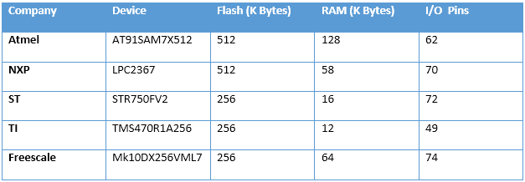
The ARM Memory Map
Why both EEPROM and Flash?
Why both SRAM and EEPROM?
IO-mapped or Memory-Mapped IO?
Memory space is 4GB; is it enough?
Microprocessors and Assembly Language, Fall 2019, AUT, Tehran, Iran

Slide 9
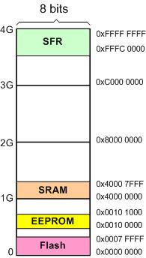
The ARM Memory Map
Q: A given ARM chip has the following address assignments. Calculate the space and the amount of memory given to each section.
(a) Address range of 0x00100000 – 0x00100FFF for EEPROM
(b) Address range of 0x40000000 – 0x40007FFF for SRAM
(c) Address range of 0x00000000 – 0x0007FFFF for Flash
(d) Address range of 0xFFFC0000 – 0xFFFFFFFF for peripherals
peripherals
Microprocessors and Assembly Language, Fall 2019, AUT, Tehran, Iran

Slide 10
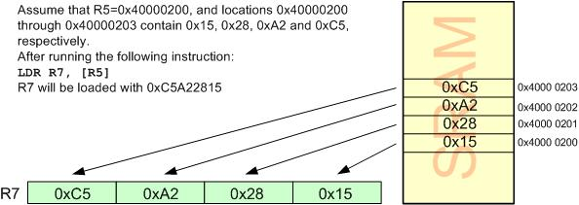
Load and Store Instructions
Load Rd with the contents of location pointed to by Rx register
LDR Rd,[Rx]; Rx contains an address between 0x00000000 to 0xFFFFFFFF
LDR reads one word (32-bit or 4-byte) of data
from 4 consecutive memory locations
The locations can be in the SRAM, a Flash memory or I/O registers
Microprocessors and Assembly Language, Fall 2019, AUT, Tehran, Iran

Slide 11
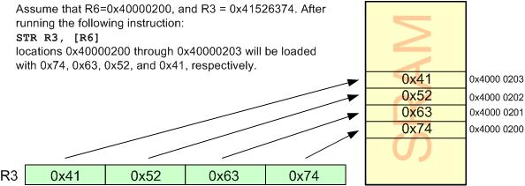
Load and Store Instructions
Store register Rd into locations pointed to by Rx
STR Rd,[Rx]
Microprocessors and Assembly Language, Fall 2019, AUT, Tehran, Iran

Slide 12
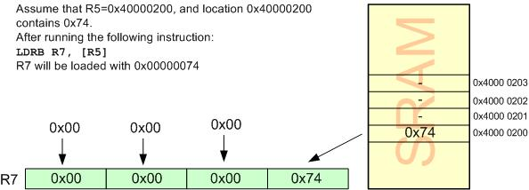
Load and Store Variations
Load a byte
LDRB Rd, [Rx]
Microprocessors and Assembly Language, Fall 2019, AUT, Tehran, Iran

Slide 13
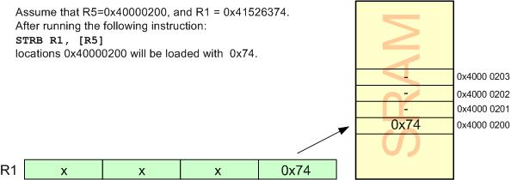
Load and Store Variations
Store a byte
STRB Rd, [Rx]
Microprocessors and Assembly Language, Fall 2019, AUT, Tehran, Iran

Slide 14
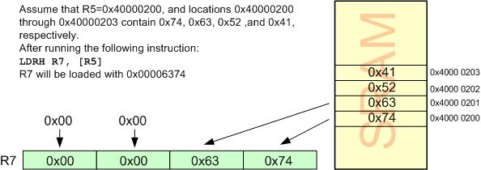
Load and Store Variations
Load half-word (2-byte)
LDRH Rd, [Rx]
Microprocessors and Assembly Language, Fall 2019, AUT, Tehran, Iran

Slide 15
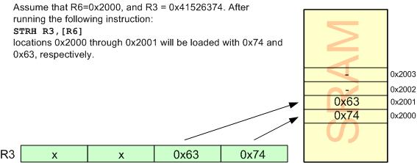
Load and Store Variations
Store half-word (2-byte)
STRH Rd, [Rx]
Microprocessors and Assembly Language, Fall 2019, AUT, Tehran, Iran

Slide 16
Current Program Status Register
CPSR: Flag register
N: Negative
Z: Zero
C: Carry
V: Overflow
T: Thumb
I and F: enable or disable the interrupt
Microprocessors and Assembly Language, Fall 2019, AUT, Tehran, Iran

Slide 17
S suffix and the status register
By executing data processing instructions
By default, the status flags of CPSR are not updated
To Update the flags
put the ‘S’ suffix at the end of the opcode
ADD => ADDS
Microprocessors and Assembly Language, Fall 2019, AUT, Tehran, Iran

Slide 18
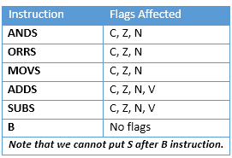
S Suffix and the Status Register
Microprocessors and Assembly Language, Fall 2019, AUT, Tehran, Iran

Slide 19
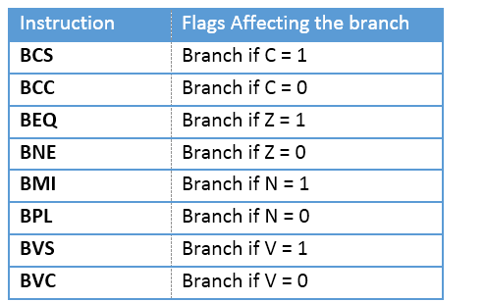
Flag Bits and Decision Making
Conditional branch instructions
Microprocessors and Assembly Language, Fall 2019, AUT, Tehran, Iran

Slide 20
ARM Data Format, Pseudo-instructions and Directives
Microprocessors and Assembly Language, Fall 2019, AUT, Tehran, Iran

Slide 21
ARM Data Format
Data format representation
Hexadecimal numbers
MOV R1, #0x99
Decimal numbers
MOV R7, #12
Binary numbers
MOV R6, #2_10011001
Numbers in any base between 2 and 9
MOV R7, #8_33
ASCII characters
LDR R3, #'2' ; R3 = 00110010 or 32 in hex
Microprocessors and Assembly Language, Fall 2019, AUT, Tehran, Iran

Slide 22
Pseudo-instructions
LDR pseudo-instruction
Limitation of loading immediate value: 8-bit
MOV Rd, 0x11223344
LDR Rd, =32-bit_immediate_value
LDR R7, =0x11223344
Load registers with the addresses of memory locations
ADR Rn, label
Microprocessors and Assembly Language, Fall 2019, AUT, Tehran, Iran

Slide 23
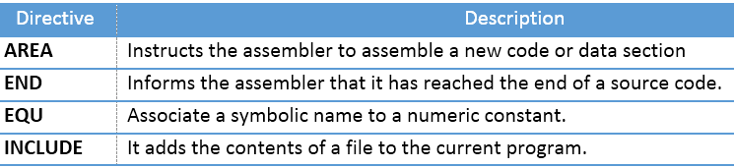
Assembler Directives
Directives give directions to the assembler
Some Widely Used ARM Directive
Microprocessors and Assembly Language, Fall 2019, AUT, Tehran, Iran

Slide 24
Assembler Directives
Directives: AREA
Defines a new section of memory
AREA sectionname, attribute, attribute, ...
Some attributes: CODE, DATA, READONLY, READWRITE, and ALIGN
AREA MY_ASM_PROG1, CODE, READONLY
Microprocessors and Assembly Language, Fall 2019, AUT, Tehran, Iran

Slide 25
Assembler Directives
Directives: AREA
Attributes: READONLY
All the READONLY sections of the same program are put next to each other in the flash memory by the linker
Attributes: READWRITE
The linker puts all the READWRITE sections of the same program next to each other in the SRAM memory
Attributes: CODE: is by default READONLY memory
Attributes: DATA: is by default READWRITE memory
Attributes: ALIGN: to align a section
Microprocessors and Assembly Language, Fall 2019, AUT, Tehran, Iran

Slide 26
Assembler Directives
Directives: END
Indicates to the assembler the end of the source code
Is the last line of the ARM assembly program
Anything after the END directive in the source file is ignored by the assembler
AREA PROG_2_1, CODE, READONLY MOV R1, #0x25 ; R1 = 0x25 MOV R2, #0x34 ; R2 = 0x34 ADD R3, R2, R1 ; R3 = R2 + R1
HERE B HERE ; stay here forever
END
Microprocessors and Assembly Language, Fall 2019, AUT, Tehran, Iran

Slide 27
Assembler Directives
Directives: END
Indicates to the assembler the end of the source code
Is the last line of the ARM assembly program
Anything after the END directive in the source file is ignored by the assembler
AREA PROG_2_1, CODE, READONLY MOV R1, #0x25 ; R1 = 0x25 MOV R2, #0x34 ; R2 = 0x34 ADD R3, R2, R1 ; R3 = R2 + R1
HERE B HERE ; stay here forever
END
Microprocessors and Assembly Language, Fall 2019, AUT, Tehran, Iran

